Slide 1


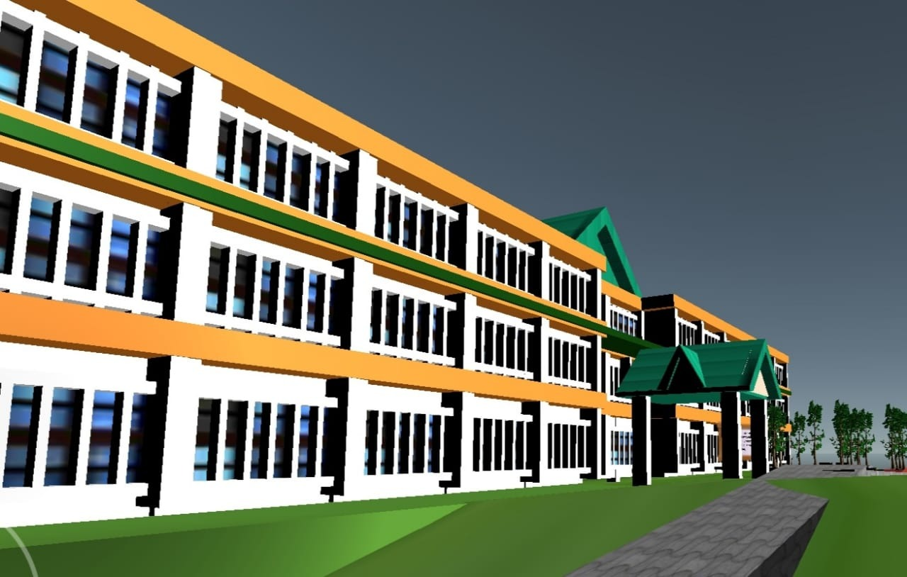
NIT HAMIRPUR VR
PROPOSED BY
TEAM VIBHAV

Slide 2
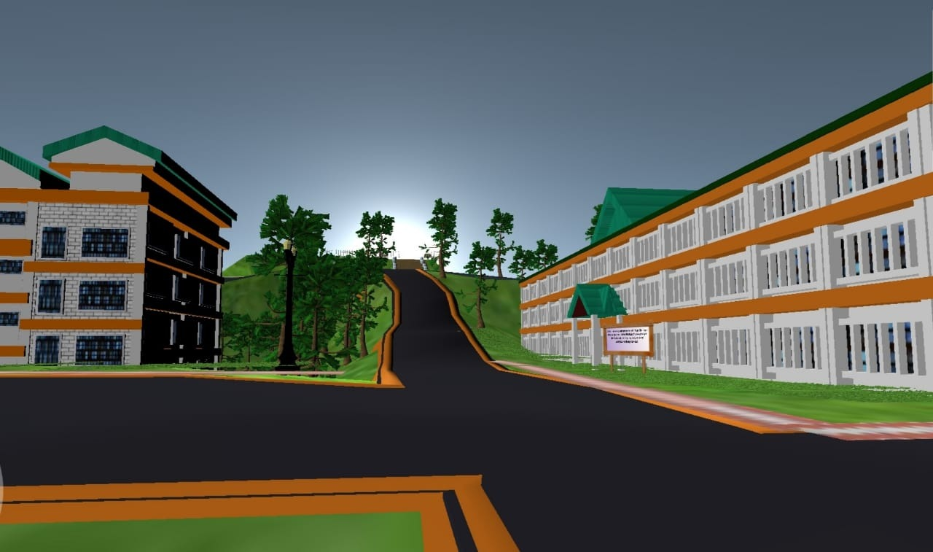
OVERVIEW
Objectives
Problem solved
Novelty
Techstack
Software used
Execution
Business Aspects

Slide 3
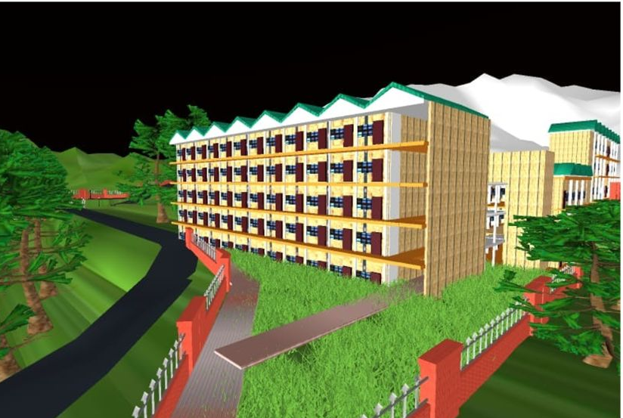
OBJECTIVES
In this project, we aim to replicate the NIT Hamirpur campus in a virtual world, so that all those who are willing to see their campus will be able to explore as well as remember their memories with their campus.

Slide 4
Problems Solved
Due to the pandemic, the college campus was off-reach for 1 year so the students couldn't visit their campus throughout the year.
The 2021 fresher batch has not yet been able to visit the college campus due to the pandemic.
All the students wish to freshen up their old college memories but are unable to do so due to strict lockdown across the country.
The students of passout batches wish to see the campus but don’t get enough time to invest in doing so.

Slide 5
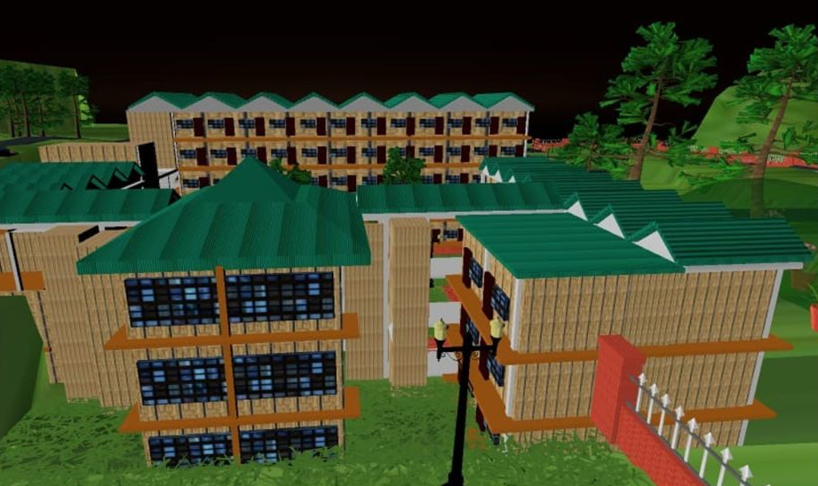
Novelty
The NIT Hamirpur VR project is an one of
its kind simulation of NITH campus with
a simple user interface.
The simulation incorporates the whole
NITH campus, not just a single part or
building.
The project provides an opportunity
for curious minds to further explore
the idea behind the project and bring
further innovations.

Slide 6
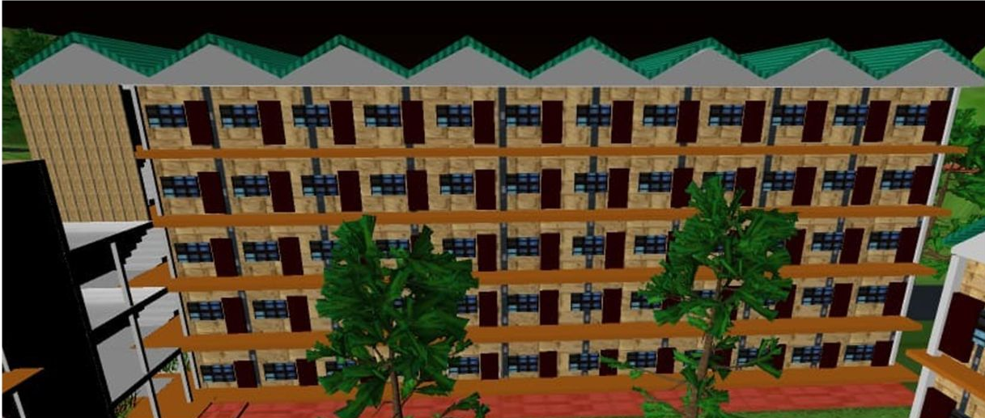
TECHSTACK
Virtual Reality
3D modelling
App deployment

Slide 7

Softwares used
Unity
Blender
Visual Studio

Slide 8
Execution
We started making 3D models of the NIT Hamirpur campus including small structures like buildings, trees, roads, playgrounds, etc.
We then exported it in the (.fbx) format and then imported it to Unity.
Using Unity, we then added many assets like a 3rd person character and a joystick for the mobile version, and scripts including scene changing, 3rd person character, 3rd person movement, joystick script, volume button, etc.
We then created a natural atmosphere by synchronizing the game time with the device time so that the user could experience day/night surroundings according to the time.

Slide 9
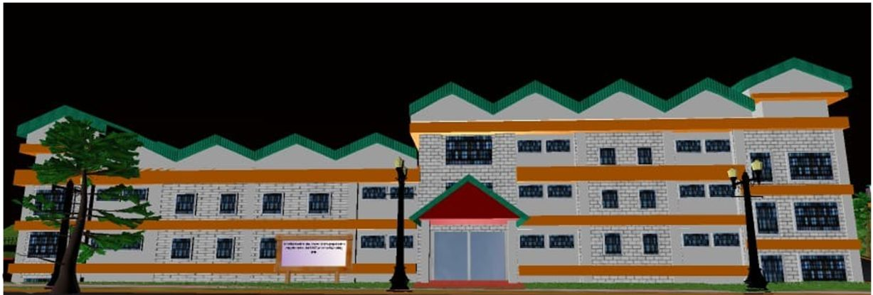
Business Aspects
We can launch it as a treasure hunt game app or launch it as a Nit Hamirpur campus tour.
Very less manpower and only two softwares are to be used so the app can pose to be a profitable venture.

Slide 10
You can now ask any of the queries nudging your curious minds
!

Slide 11


Team Vibhav
Thanks you for your time!

